Slide 1
Chongqing University of Technology
ATAI
Advanced Technique of Artificial Intelligence
Chongqing University of Technology
图约束汇总
Reported by Xinsheng Wang

Slide 2
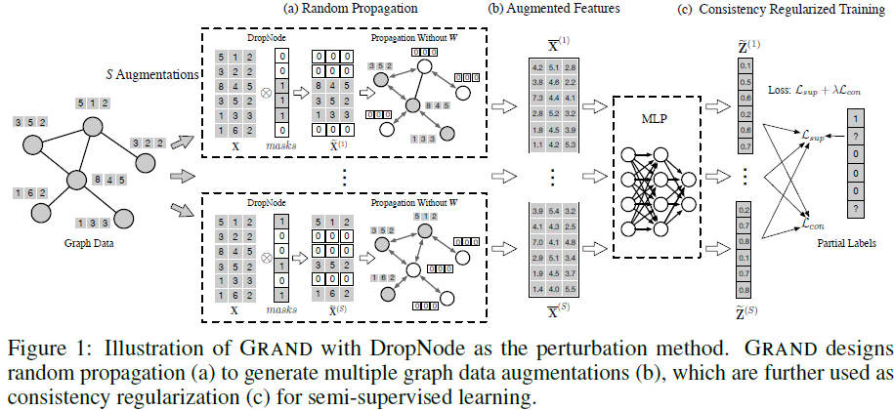
NIPS_2020_Graph Random Neural Networks for Semi-Supervised Learning on Graphs

Slide 3
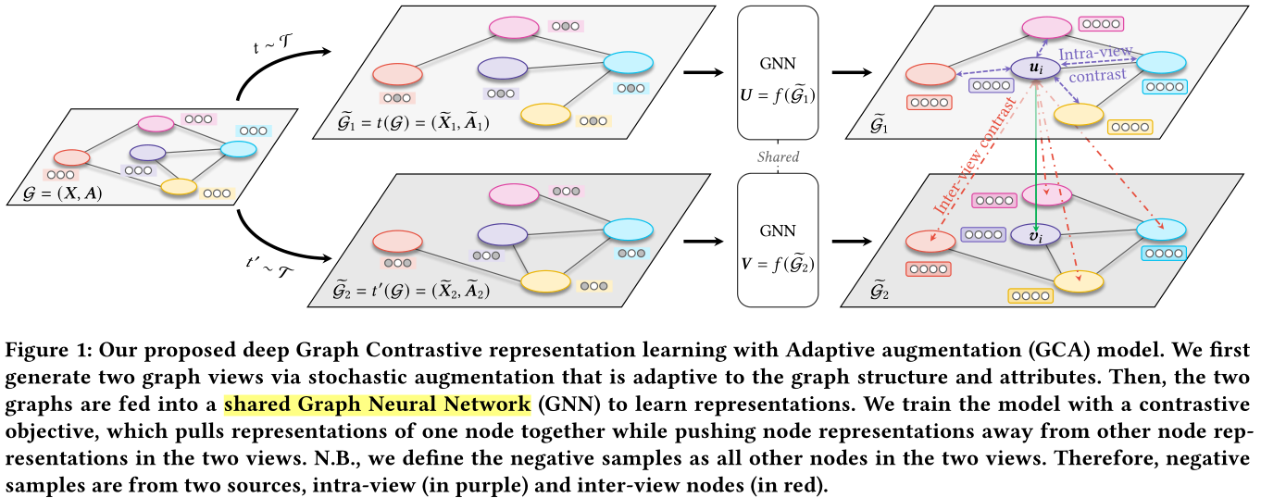
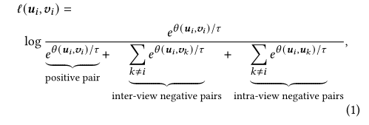
WWW_2021_Graph Contrastive Learning with Adaptive Augmentation

Slide 4
思想
WWW_2021_Graph Contrastive Learning with Adaptive Augmentation
Notes:
数据增强：
1、拓扑结构：移除一些不重要的边(通过计算边的一个重要性分数来移除边)；
2、节点特征：采用伯努利分布来随机生成0、1序列(长度为特征长度)，生成的序列和节点特征相乘，得到新的特征

Slide 5
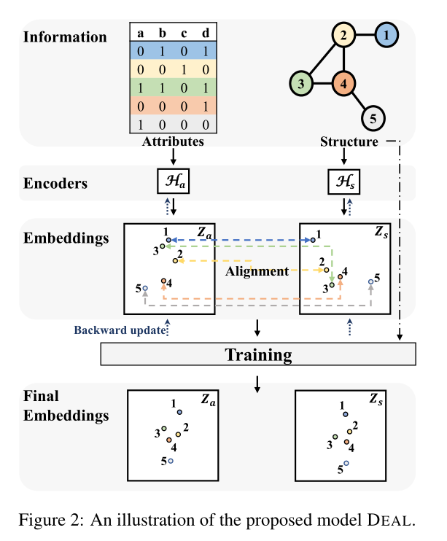
Method
节点对，可有边，可无边
有边
无边
IJCAI_2021_Inductive Link Prediction for Nodes Having Only Attribute Information
Notes:
用MLP(多层感知器)来得到节点属性的embedding，其中激活函数是elu
距离近，则权重就大，则说明相似度就高
在损失中用到了结构信息，yi表示存在边

Slide 6
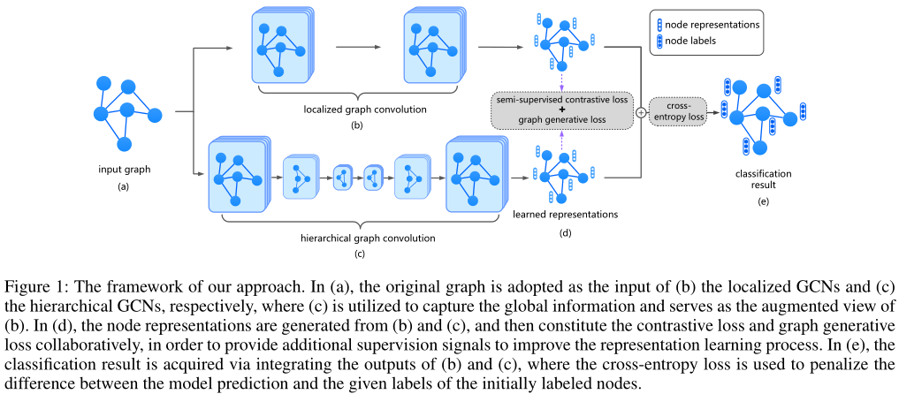
Method
无监督
有监督
AAAI_2021_Contrastive and Generative Graph Convolutional Networks for Graph-based Semi-Supervised Learning
Notes:
3、4、5是GCN之后的每个结点的表示的Loss，每个hi都是一个向量，H是个矩阵(GCN最后得到的结果都是矩阵)---无监督，使得对应节点尽可能相似
6、7、8为有监督约束，在有标签的样本中，如果两个节点的类别相同，则让二者的表示尽可能相似

Slide 7
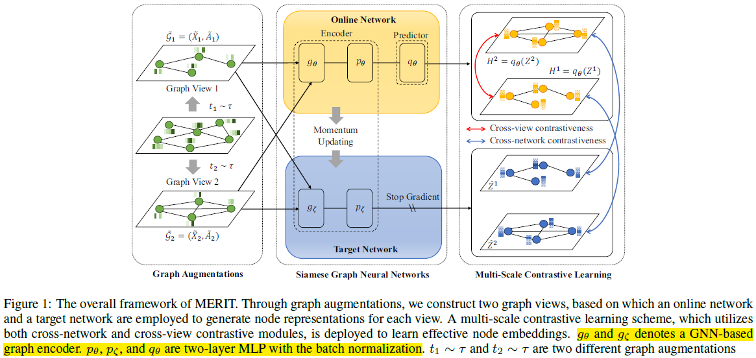
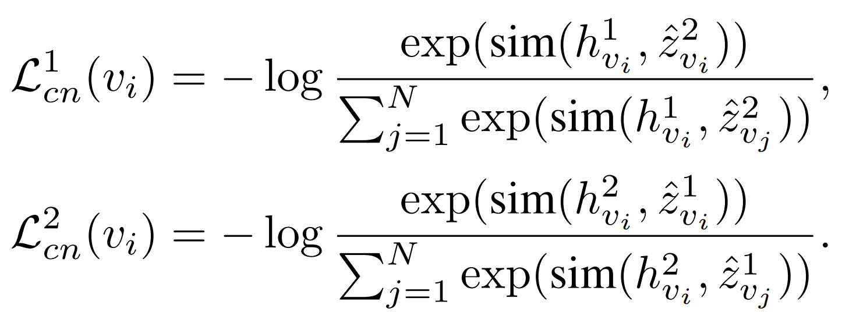
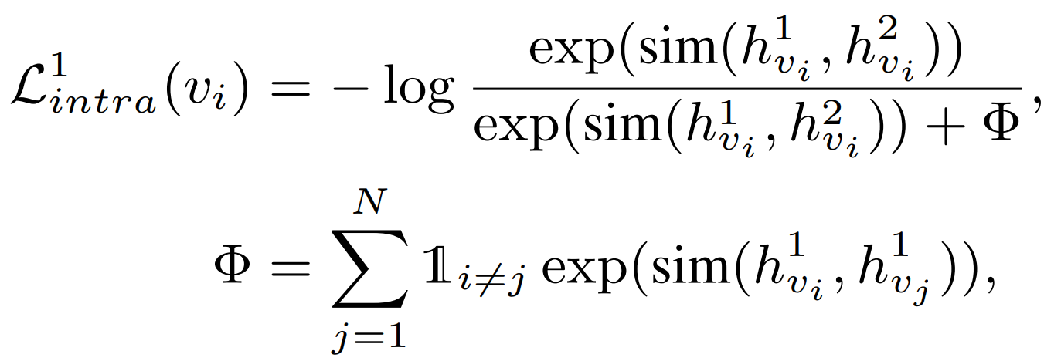
IJCAI_2021_Multi-Scale Contrastive Siamese Networks for Self-Supervised Graph Representation Learning

Slide 8
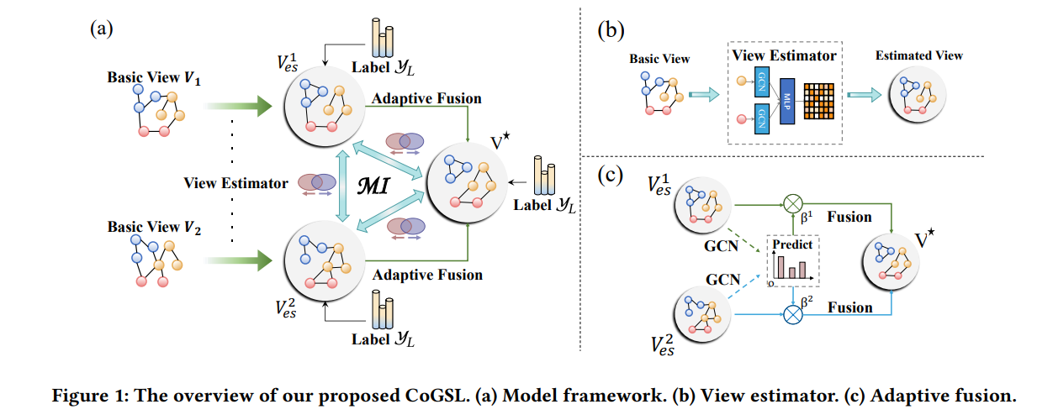
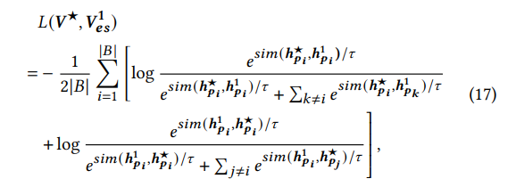
WWW_2022_Compact Graph Structure Learning via Mutual Information Compression

Slide 9
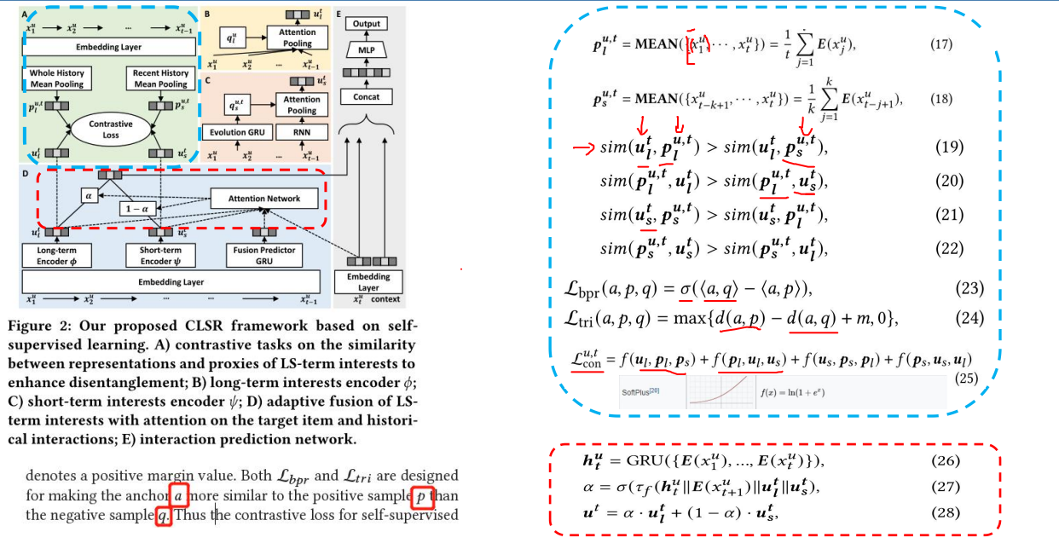
WWW_2022_Disentangling Long and Short-Term Interests for Recommendation

Slide 10
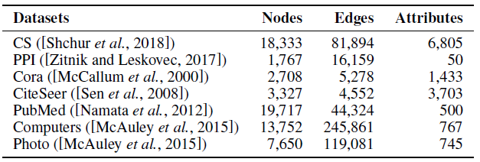
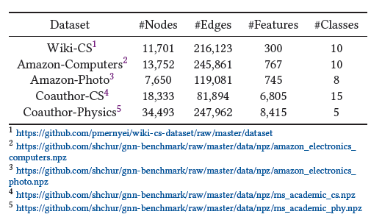
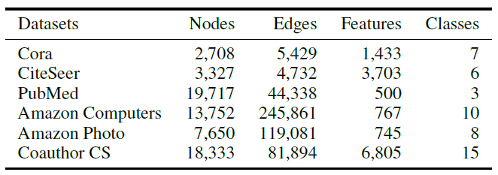
IJCAI_2021_Inductive Link Prediction for Nodes Having Only Attribute Information
WWW_2021_Graph Contrastive Learning with Adaptive Augmentation
AAAI_2021_Contrastive and Generative Graph Convolutional Networks for
Graph-based Semi-Supervised Learning

Slide 11
不同图空间的约束总结(4篇)
WWW_2021_Graph Contrastive Learning with Adaptive Augmentation
IJCAI_2021_Inductive Link Prediction for Nodes Having Only Attribute Information
AAAI_2021_Contrastive and Generative Graph Convolutional Networks for Graph-based Semi-Supervised Learning
IJCAI_2021_Multi-Scale Contrastive Siamese Networks for Self-Supervised Graph Representation Learning
知识蒸馏和孪生网络对比总结(2篇)
IJCAI_2021_Multi-Scale Contrastive Siamese Networks for Self-Supervised Graph Representation Learning
A Dual-Channel Knowledge Distillation Framework for Node Classification(ours)

